Slide 1
Overview of Land Cover Remote Sensing

Slide 2
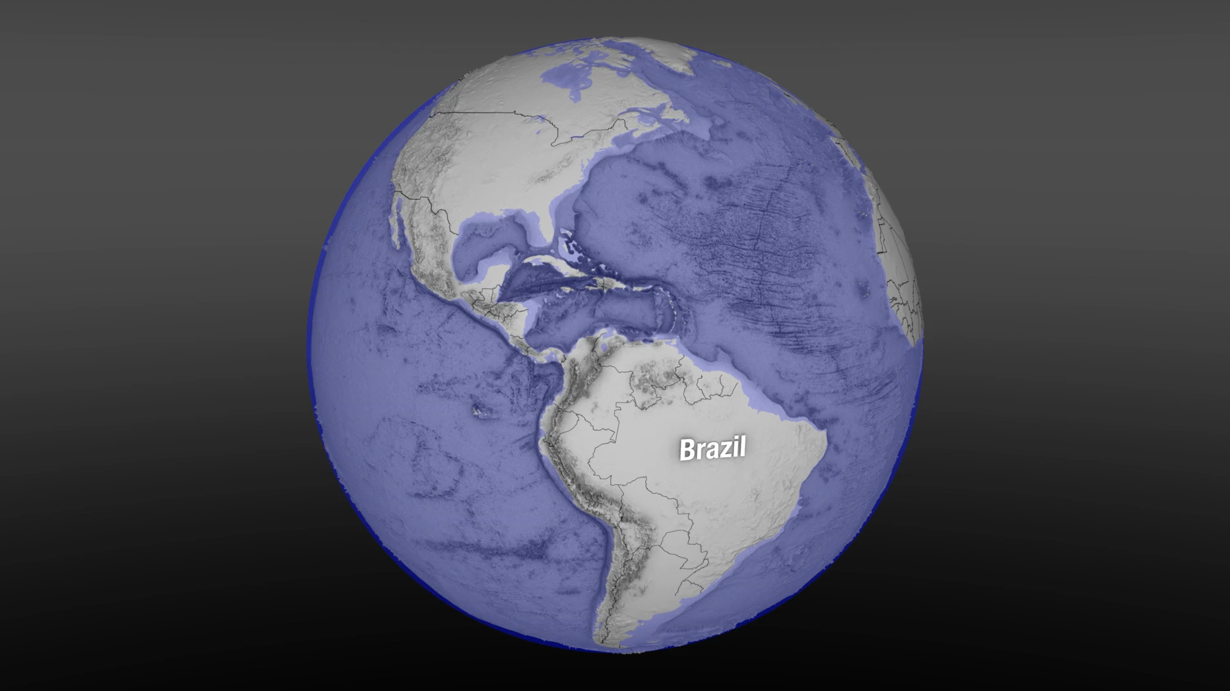

Slide 3
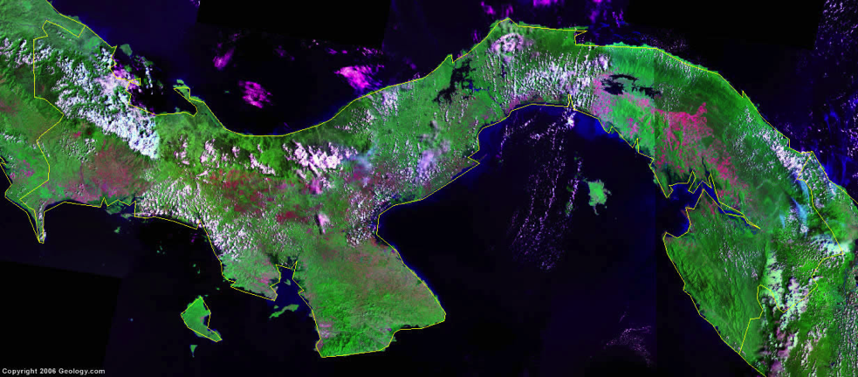
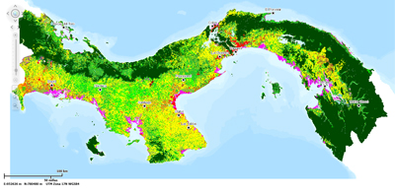
Turning Data Into Information
Spectral vs. Informational Classes
Spectral Classes
Groups of pixels that are uniform with respect to their pixel values in several spectral bands
Informational Classes
Categories of interest to users of the data (i.e., water, forest, urban, agriculture, etc.)
Image classification is the process of grouping spectral classes and assigning them informational class names.
Satellite image of Panama
Land cover map of Panama

Slide 4
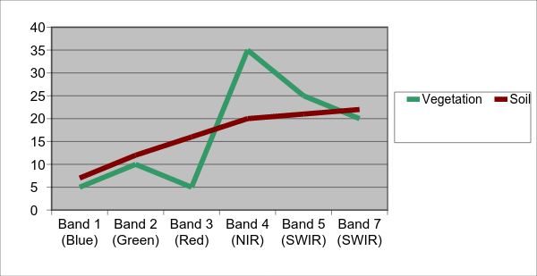
Land Cover Mapping Basics
Objects on the ground reflect electromagnetic radiation differently in different wavelengths.
That is called the object’s spectral signature.
Example: Green vegetation absorbs Red wavelengths but reflects NIR wavelengths
Percent Reflectance
Landsat Bands

Slide 5
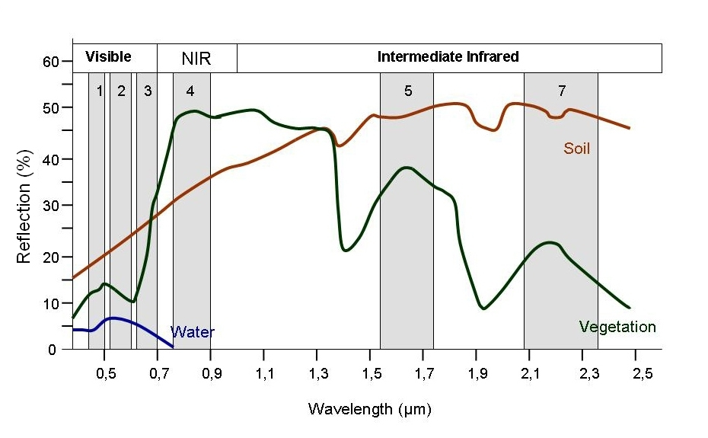
Land Cover Mapping Basics
Spectral Plots
Objects (soil, water, and vegetation) fall in different places in the plot.
Look at spectral signatures by plotting Band 3 (Red) vs. Band 4 (NIR) reflectance values.
The software uses this to distinguish between different land cover types.
Band 3 reflectance
dry soil
water
vegetation
Band 4 reflectance

Slide 6
Land Cover Mapping Basics
Spectral Plots
Now we will look at spectral signatures a little differently by plotting Band 3 (Red) vs. Band 4 (NIR) reflectance values.
When you do this, you see the objects (soil, water, and vegetation) fall in different places in the plot.
The software (QGIS and others) uses this information to distinguish between different land cover types.
Band 3 reflectance
dry soil
water
vegetation
Band 4 reflectance

Slide 7
Spectral Signatures
There is some variation in reflectance values at different wavelengths.
Depending on the land cover classes you want, the trick is to identify this variability.

Slide 8
Spectral Variation
Easier: distinguishing between broad classes
e.g., vegetation and soil
Harder: distinguishing within broad classes
e.g. vegetation types
Variation within and between type (broad classes) is below.
Vegetation
Soil

Slide 9
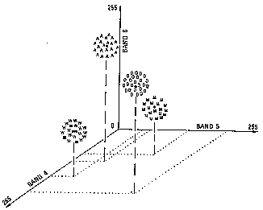
Multi-Dimensional Spectral Plots
When looking at spectral plots, each band represents a different dimension.
For example, this is a 2-dimensional plot:
In a spectral plot, pixels are plotted in n-dimensional space (where n represents the number of bands).
This is an example of a 3-dimensional spectral plot:
Band 3 reflectance
dry soil
water
vegetation
Band 4 reflectance
Sabins, F. F. (1987). Remote Sensing: Principles and Interpretation (2nd ed.). W.H. Freeman and Company.

Slide 10
Image Classification
Requires delineating boundaries of classes in n-dimensional space using class statistics
Each group of pixels is characterized by:
min.
max.
mean
standard deviation
All the pixels in the image that fall within those statistics are given those labels.
Vegetation
Soil

Slide 11
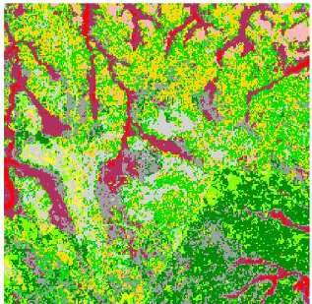
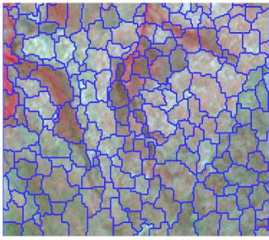
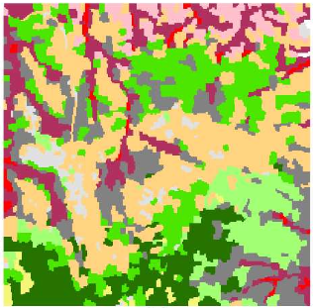
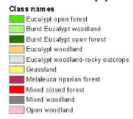
Image Classification (Approaches)
Pixel-Based
Each pixel is grouped in a class
Useful for multiple changes in land use within a short period of time
Best for complete data coverage and a need for methods to ensure time series consistency at the pixel level
Object-Based
Pixels with common spectral characteristics are first grouped together (segmentation)
Useful for:
Reducing speckle noise in radar images
High resolution imagery
Whiteside, T., & Ahmad, W. (2005, September). A comparison of object-oriented and pixel-based classification methods for mapping land cover in northern Australia. Proceedings of SSC2005 Spatial intelligence, innovation and praxis: The national biennial Conference of the Spatial Sciences Institute.
Notes:
There are many different ways to classify imagery but almost all can be categorized into two approaches: pixel based and object based. In pixel-based approaches, each pixel is grouped into a spectrally similar class. These approaches are most useful where there are multiple changes in land use within a short period of time, and they are best suited when there is wall to wall data coverage and time series consistency at the pixel level is required.
Object-based approaches partitions an image into groups of pixels that are spectrally similar and spatially adjacent. Boundaries of pixel groups delineate ground objects in much the same way a human analyst would do based on its shape, tone, and texture. This process is called segmentation. These kinds of images can be easier for an analyst to interpret. This approach is also used on radar imagery to reduce speckle. It is especially useful for high spatial resolution imagery because pixel-based approaches tend to be very noisy.
The images below show the visual differences between the two approaches. On the right is the pixel based approach and on the right, you can see the same image that has been segmented and classified. It produces a much smoother image.
http://www.ecognition.com/sites/default/files/273_0168.pdf
Image segmentation is the process of partitioning an image into groups of pixels that are spectrally similar and spatially adjacent

Slide 12
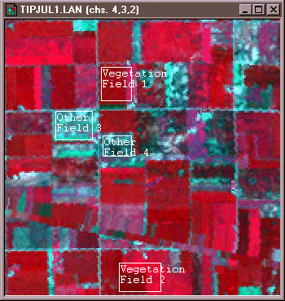
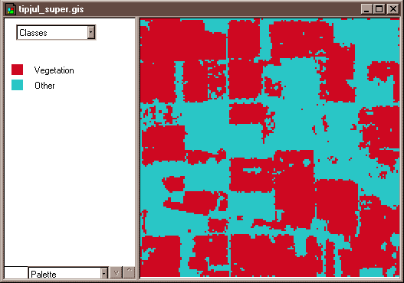
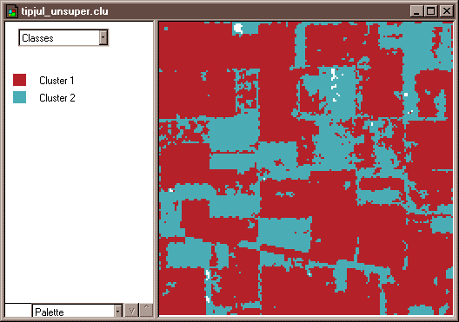
Image Classification (Methods)
Supervised
Uses expert-defined areas of known vegetation types (training areas) to tune parameters of classification algorithms
Algorithm then automatically identifies and labels areas similar to the training data
Unsupervised
Uses classification algorithms to assign pixels into one of a number of user-specified class groupings
Interpreters assign each of the groupings of pixels a value corresponding to a land cover class
Credit: David DiBiase, Penn State Department of Geography
Notes:
Two different methods are typically used to create land cover maps. The supervised method can use either a pixel-based approach or an object-based approach. The unsupervised method uses a pixel-based approach. The supervised method uses user-defined areas of known land cover types that are called training areas. These areas are then used to define the statistical parameters of classification algorithms. The algorithm then automatically identifies and labels all pixels or segments that are statistically similar to the training data.
In the unsupervised method, a classification algorithm assigns each pixel into one of a number of user-specified classes. Then interpreters assign each of the pixel groupings a value corresponding to a land cover class.
I’m going to describe to you a little more about the supervised approach.
https://www.e-education.psu.edu/natureofgeoinfo/c8_p18.html

Slide 13
Supervised vs. Unsupervised Classification
Supervised
Unsupervised
Select Training Fields
Edit/Evaluate Signatures
Classify Image
Evaluate Classification
Run Clustering Algorithm
Identify Classes
Edit/Evaluate Signatures
Evaluate Classification

Slide 14
Image Classification (Supervised Method)
Supervised classification requires the analyst to select training areas where they know what is on the ground, and then digitizes a polygon within that area.
Mean Spectral Signatures
Conifer
Known Conifer Area
Water
Known Water Area
Deciduous
Known Deciduous Area
Digital Image
Sutton, L. Image Classification. Materials from Satellite Image Classification & Change Detection at Portland State University.
Notes:
A supervised classification method requires the analyst to select training areas where they know what is on the ground. Then they digitize a polygon within that area. Or, if the image has been segmented then the analyst identifies segments associated with known land cover types. These known land cover types can be identified through field work, or through the visual interpretation of aerial photos or high-resolution imagery. Each known area has its own statistical characteristics or spectral signature. The image shows three simplified land cover types, conifers, water and deciduous vegetation and their associated spectral signatures.

Slide 15
Image Classification (Supervised Method)
The spectral signature of each pixel gets matched with the training signatures and the image is classified accordingly.
Mean Spectral Signatures
Multispectral Image
Information
(Classified Image)
Conifer
Spectral signature of next pixel to be classified
Deciduous
Unknown
Water
Notes:
The spectral signatures from the training areas are then used to categorize each pixel, or each segment in the image resulting in the entire image being classified.

Slide 16
Training Sites (or Regions of Interest [ROI])
Key Characteristics
General rule: If using n bands of data, then >10n pixels of training data should be collected for each class.
Size: Must be large enough to provide accurate estimates of the properties of each class.
Location: Each class should be represented by several training areas positioned throughout the image.
Number: 5 to 10 per class minimum. You want to make sure spectral properties of each class are represented.
Uniformity: Each training area should exhibit unimodal frequency distribution for each spectral band.

Slide 17
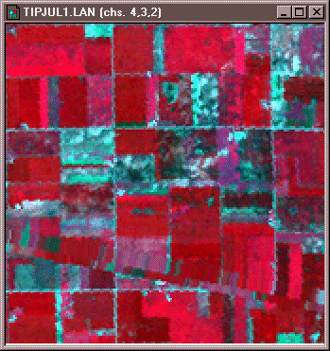
Selecting training sites
Minimizing confusion
Confusion of land cover classes is common in land cover classification because:
Land cover types are spectrally similar (i.e., different vegetation or crop types)
Shadows or clouds
Training sites are delineated too broadly OR they are not capturing enough variability.
This training site includes too many land cover types and therefore too much spectral variability.
These training sites better represent the spectral variability in agricultural fields.

Slide 18
Introduction to Google Earth Engine Functionalities and Available Data Types
Notes:
And I just want to quickly remind you all that this will be a basic intro, so if you’re a little more advanced with GEE, we might go over some things you already know, but this session is to make sure we’re all on the same page with the basics of the platform. Ok let’s get started with our first section discussing GEE functionalities and available data types.

Slide 19
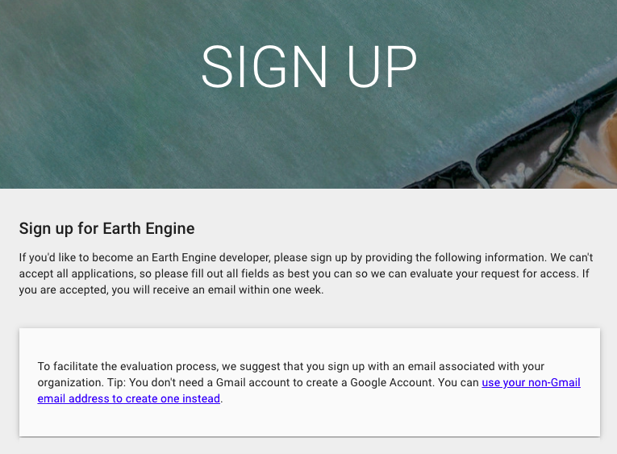
Google Earth Engine Account Reminder
Make sure you sign up for a Google Earth Engine account as soon as possible, if you haven’t already, using the link below:
https://signup.earthengine.google.com/#!/
A Gmail address is not required. It is recommended that you use your work/institutional email.
Notes:
I also wanted to remind you all that you’ll need a Google Earth Engine account to participate in our activities. If you haven’t already, make sure you go to the link listed here, which can also be found on the training webpage, to sign up for an account. Google Earth Engine accounts are free, and you do not need to have a gmail in order to sign up for one. They do however recommend that you use your work or institutional email. You can also just search “google earth engine account sign up” in your browser. Hopefully you saw the instructions to sign up for this account ahead of time, but if not, don’t worry about it. You can follow along with the activity on-screen since I will be mirroring the code editor as we go through code. But make sure to sign up for that account as soon as possible.

Slide 20
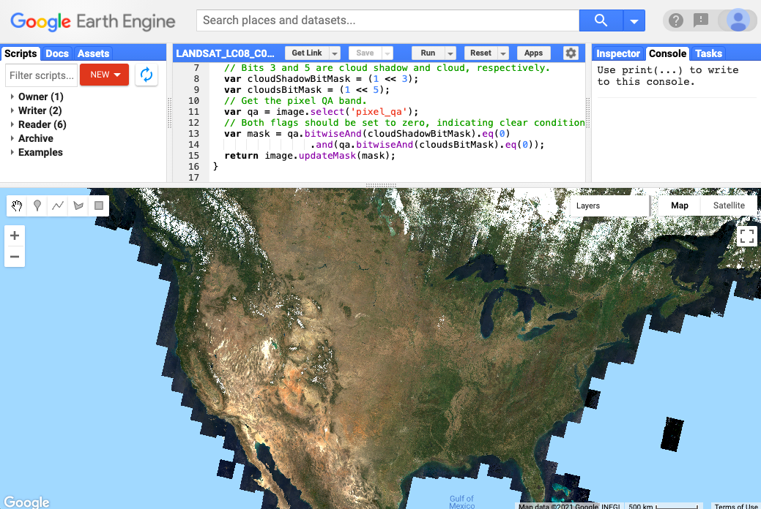
Cloud-Based Raster Computing for Remote Sensing Analysis
Cloud-based raster computing removes barriers and limitations related to…
Data hosting and storage
Imagery access and availability
Personal computing capabilities
GEE is also free for scientists, researchers, and developers.
Google Earth Engine code editor interface using the JavaScript API, displaying Landsat 8 surface reflectance true color imagery for the U.S.
Credit: Google Earth Engine Developers
Notes:
So you may have already heard some of the buzz surrounding cloud-based raster computing for remote sensing analysis. Computing in the cloud has a variety of potential benefits. Since you’re not limited by your own personal computing capabilities, you may be able to process larger datasets simultaneously or reduce the time it typically takes to process data. Cloud resources can also typically host and store more data. And since the cloud can be accessed from anywhere these large stores of imagery and other data types are accessible from anywhere as long as you have an internet connection. With particular reference to GEE, the barrier of cost is also removed for scientists, researchers, and developers since the platform is freely available to these user groups.

Slide 21
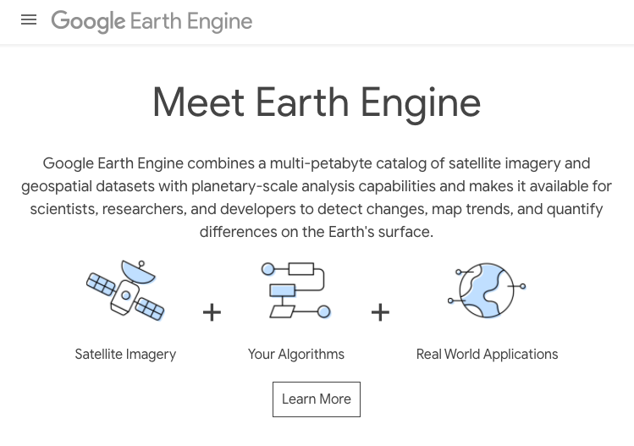
The Google Earth Engine Platform
Google Earth Engine (GEE) takes advantage of cloud computing capabilities to provide users with a single place for accessing satellite data, applying remote sensing methodologies, and displaying analysis results.
GEE’s application programming interface (API) allows users to easily apply land cover monitoring algorithms and classifications with coded commands.
Image Credit: Google Earth Engine
Notes:
The GEE platform leverages the advantages of cloud computing to provide users with a single place for accessing satellite data, applying remote sensing methodologies, and displaying analysis results. Google’s access to data storage and computing infrastructure allow the platform to host large remote sensing datasets and provide access to global imagery archives. And particularly relevant to our interest in GEE for this training series, the application programming interface, or API, can allow users to easily apply algorithms to complete things like land cover monitoring.

Slide 22
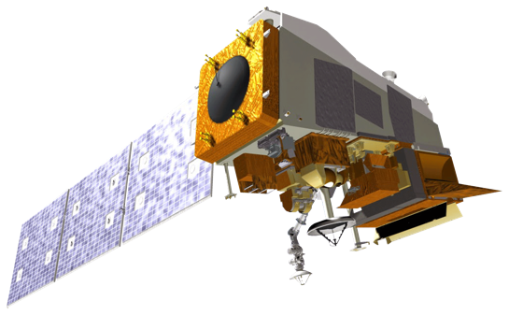

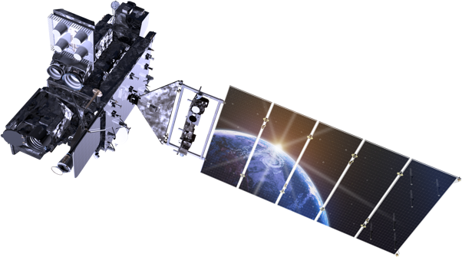
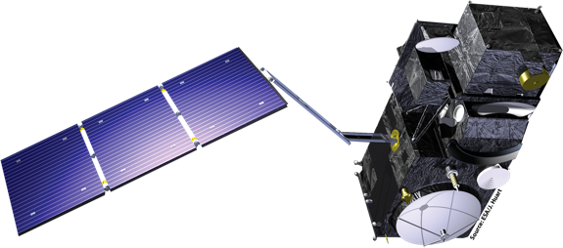
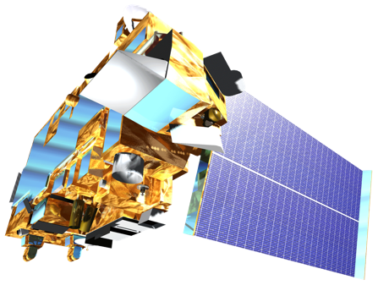
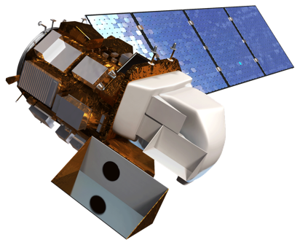
Notes:
Close collaboration with Google Cloud and satellite data from NASA, ESA, and other data providers.

Slide 23
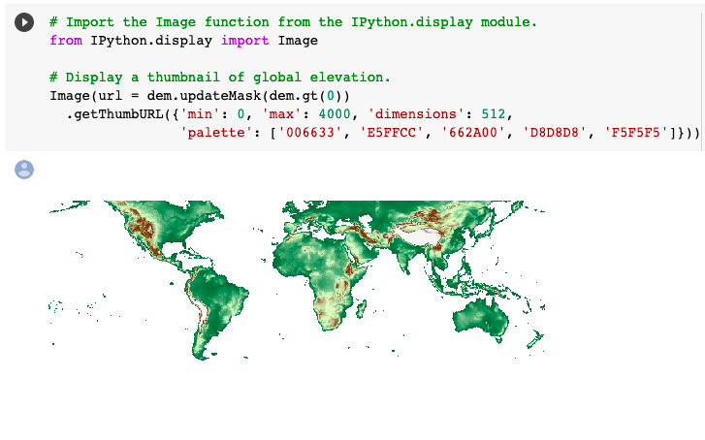
Application Programming Interface (API)
The Earth Engine JavaScript API is currently the most widely used method of working with GEE.
A Python API through Google Colaboratory (Colab) is also available for those interested in using Python.
This is a bit more complicated than working directly in the GEE code editor with JavaScript.
Google Colab notebook using a coded section to display elevation in an output cell. Credit: Google Colab
Notes:
The GEE JavaScript API, and specifically the GEE code editor interface, is the most common method for interacting with GEE. It’s also the most frequently used by developers, so a lot of useful scripts and base code can be found online in the JavaScript API. I know many of you may already have experience working with Python and are likely wondering if you can use Python rather than JavaScript, and the short answer is yes. A Python API for GEE is available through the Google Colaboratory, or Colab. It can be al little more difficult to use, and it’s not quite as common, so we will be focusing most of our time on the JavaScript API, but we’re going to take a quick look at Colab at the end of this session. Google Colab essentially uses a specialized version of Jupyter Notebooks as an interface, so if you’re familiar with Jupyter notebooks, you might be interested in using Colab. The screenshot on this slide shows an example of visualizing a single map within the Colab interface.

Slide 24
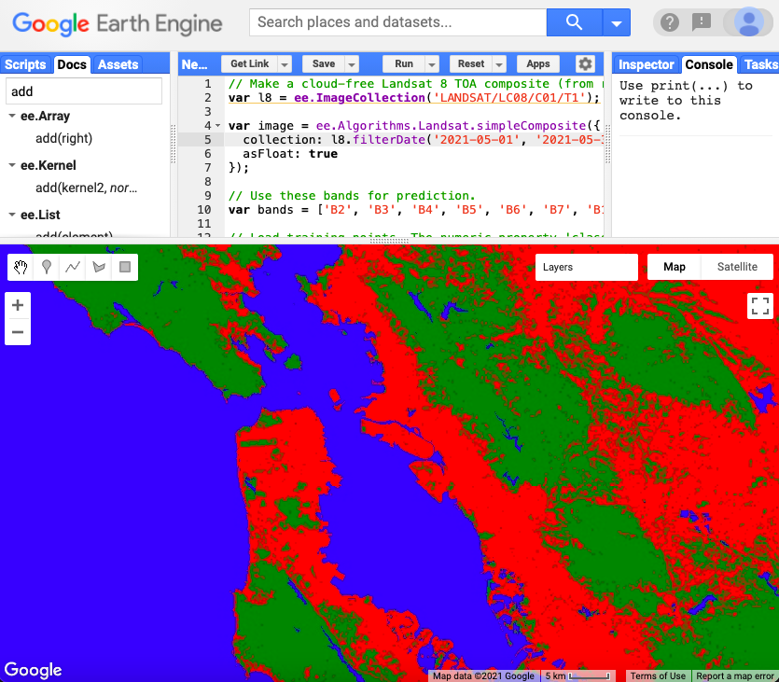
Google Earth Engine Functionality
Uses of GEE for satellite imagery analysis include:
Automation of data processing and display
Near real-time monitoring (limited by the availability of data in the catalog)
Machine learning algorithm application
Graphical User Interface implementation
Simple Classification and Regression Trees (CART) classifier implemented in the GEE API to identify three classes urban, forest, and water in the San Francisco Bay Area for May 2021 using Landsat 8 imagery. Credit: Google Earth Engine Developers
Notes:
A quick survey of some of the basic functionalities of Google Earth Engine relevant for satellite imagery analysis, includes automation of data processing and display, near-real time monitoring, machine learning algorithms, and the implementation of graphical user interfaces. These capabilities can assist with the processing of large datasets and the application of algorithms to multiple images over a time series as well as making results and data visualizations more accessible. You’ll also note that many of these function are common in more traditional GIS platforms like ArcGIS and QGIS, so it’s important to note that many functions that you currently use in a desktop GIS platform are also available in GEE. And here on the slide we have a screenshot of the GEE code editor interface, displaying a Classification and Regression Trees (or CART) classifier implemented over the San Francisco Bay Area using Landsat 8 imagery to complete a simple land classification delineating urban, forest, and water cover types. Just to give you a quick example of what this looks like.

Slide 25
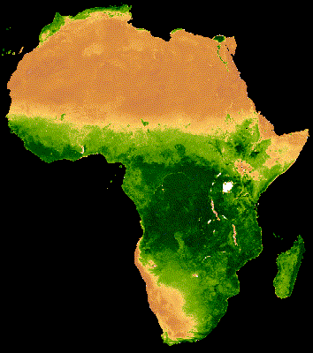
GEE Land Applications
Long-term monitoring of landscape change and land cover type
Computation of indices relevant to land management such as normalized difference indices for vegetation, water, snow, soil, and urban areas
Landscape time series analysis and change detection
Summary statistics
Validation and accuracy assessment methods
Visualization and presentation of results
Time series of MODIS NDVI displayed using Google Earth Engine. Image Credit: Google Earth Engine Developers
Notes:
So as was alluded to on the previous slide, GEE has a lot of potential for land monitoring applications. Applications like long-term monitoring of landscape change; computation of relevant indices evaluating parameters like vegetation, soil, snow cover; and time series and change detection analysis of land surface features. GEE also includes functionalities for calculating summary statistics, validation and accuracy assessment, and visualization and presentation of results. The Earth Engine developers have really tried to make the platform as robust as other GIS platforms for processing, analyzing, and displaying satellite data.

Slide 26
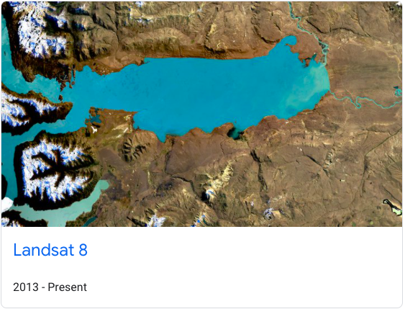
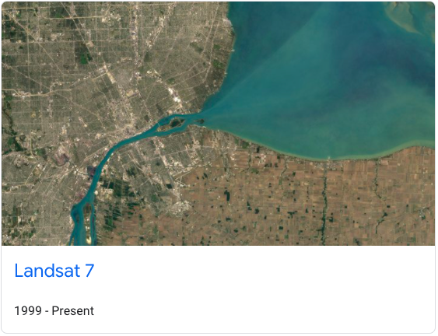
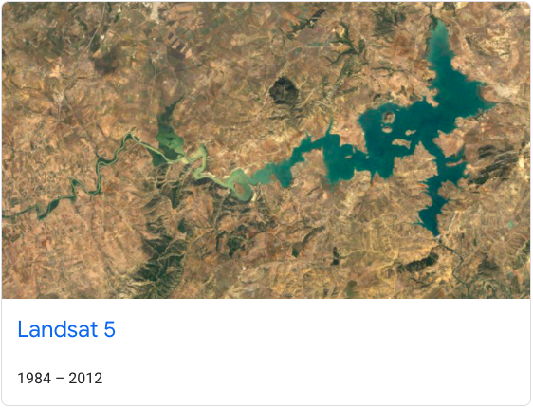
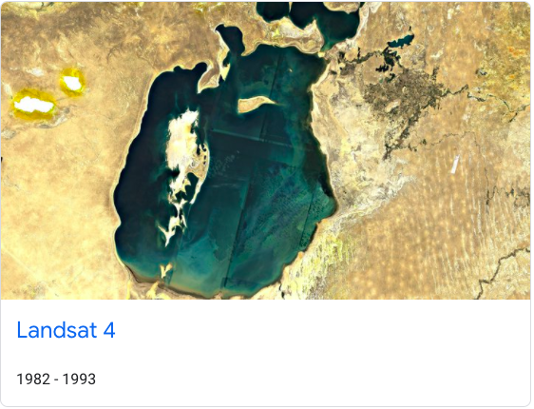
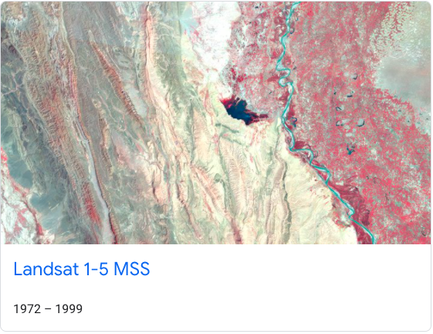
Available Satellite Sensor Data in GEE: Landsat Series
Data from the entire Landsat series is available for use in GEE, including:
Landsat 1-5
Multispectral Sensor Radiance
Landsat 4-8
Raw Images
Top of Atmosphere
Surface Reflectance
The full archive includes data from 1972 to present day, with data from 1982 onward at 30m resolution (Landsat 4-9).
GEE Data Catalog Link:
https://developers.google.com/earth-engine/datasets/catalog/landsat
Available Landsat series collections in the GEE data catalog. Image Credit: Earth Engine Data Catalog
Notes:
Now let’s talk about some of the relevant satellite data products that are hosted and available in GEE. The first, and potentially most extensive, is the Landsat Series, with data from all successful Landsat missions. The total series covers 1972 to present day, and with data from Landsat 4 through 8, there is 30 meter spatial resolution data available from 1982 onward. This includes raw images, top of atmosphere reflectance, and surface reflectance data products. These products are separated into tiers, with tier 1 representing the highest quality images with the least cloud cover. However, tier 2 images are still good, but they may have higher cloud cover and more atmospheric influences. Using tier 1 images can reduce the need for cloud masking or filtering within your analysis, since they have already been selected for their high quality, but all images should be filtered for cloud cover. On this slide and the next few slides I have provided the Earth Engine data catalog link for your reference so you can take a closer look at available data products.

Slide 27
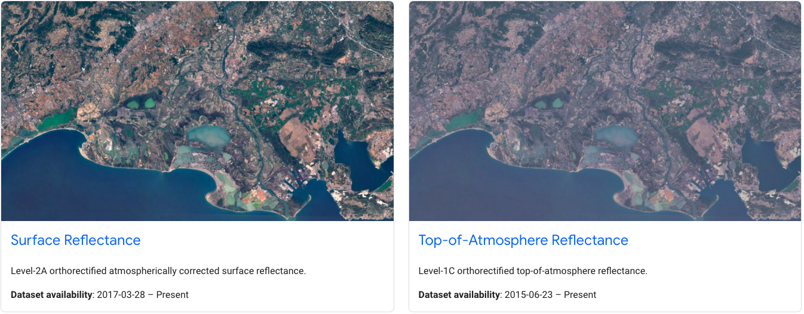
Available Satellite Sensor Data in GEE: Sentinel-2
Available Sentinel-2 data includes:
Top of Atmosphere
Surface Reflectance
Sentinel-2 land applications are very similar to those of Landsat, but differences include:
10-20m spatial resolution
5-day revisit
Less temporal coverage
GEE Data Catalog Link:
https://developers.google.com/earth-engine/datasets/catalog/sentinel-2
Available Sentinel-2 data products in GEE. Note the temporal coverage starts in 2015 and 2017. Image Credit: Earth Engine Data Catalog
Notes:
Sentinel-2 data is also available through GEE and includes top of atmosphere and surface reflectance products. The applications of Sentinel-2 data are very similar to Landsat, but there are a few notable differences. Sentinel-2 has a higher spatial resolution of 10-20m, a 5-day revisit, but has less overall temporal coverage as the data doesn’t start until 2015. Sentinel-2 is often used in conjunction with Landsat 8 data to provide an overall higher temporal resolution. Its higher spatial resolution is also often helpful for finer differentiation of land cover types.

Slide 28
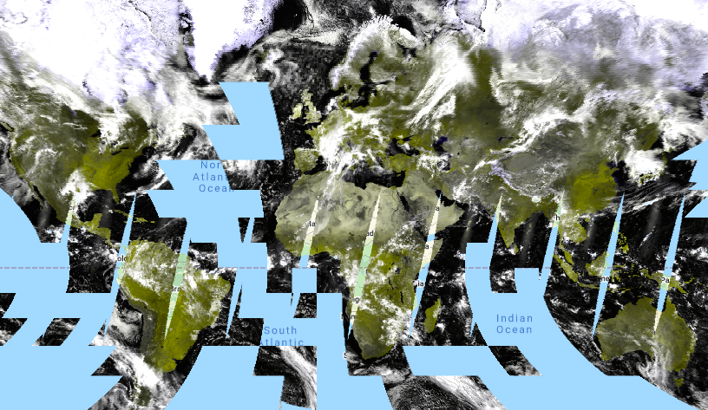
Available Satellite Sensor Data in GEE: MODIS
MODIS reflectance data products include:
Daily, 500m Nadir BRDF-Adjusted Reflectance
Daily, Global, 250m Surface Reflectance
8-Day, Global, 250m Surface Reflectance
Pre-processed products include:
Daily, Global, 500m Snow Cover
16-Day, Global, 250m Vegetation Indices
Yearly, Global, 500m Land Cover Type
False color image of the Terra Surface Reflectance Daily Global 250m projected in the GEE JavaScript API. Credit: Google Earth Engine Developers
MODIS GEE Catalog Link:
https://developers.google.com/earth-engine/datasets
/catalog/modis
Notes:
GEE also contains the MODIS archive, you’re likely already familiar with MODIS in some capacity, but as a reminder, MODIS data spans from 2000 to present day and is pretty popular due to its high temporal resolution, with a daily revisit time. In terms of reflectance products, I would say two of the most valuable for completing your own land monitoring tasks are the Daily and 8-day, global, 250m surface reflectance products. The 8-day product composites the highest quality pixels over an 8 day period, which means this product might be particularly useful if your study area is in a place that frequently experiences cloud cover. This surface reflectance data has similar capabilities to that of Landsat, but the reduced spatial resolution can be challenging for smaller study areas. And here on the slide I’ve displayed an example of the daily, global MODIS surface reflectance product in the GEE map. There are also a variety of pre-processed MODIS products that you might find useful, such as snow cover, vegetation indices, and land cover type.

Slide 29
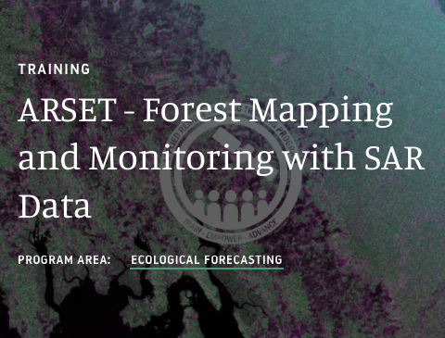
Available Satellite Sensor Data in GEE: Sentinel-1 SAR
Pre-processed SAR data from Sentinel-1 is available to work with in GEE.
Previous ARSET training:
Forest Mapping and Monitoring with SAR Data
GEE Data Catalog:
https://developers.google.com/earth-engine/datasets/catalog/COPERNICUS_S1_GRD
A previous ARSET training details the use of SAR data for land management, particularly in vegetated ecosystems.
Link: ARSET
Notes:
Another dataset you might find useful is Sentinel-1 SAR. This data is pre-processed and ready for use in GEE. We’re going to be focusing on optical imagery for this series, but I wanted to make sure this radar data source was included. SAR data is especially useful for vegetation mapping, and if you would like to engage with this type of data further in GEE, I recommend checking out our Forest Mapping and Monitoring with SAR data training. This training goes through a variety of exercises to show you how to manipulate SAR data from a couple of different sensors in GEE. You can find it here on the link we’ve provided.

Slide 30
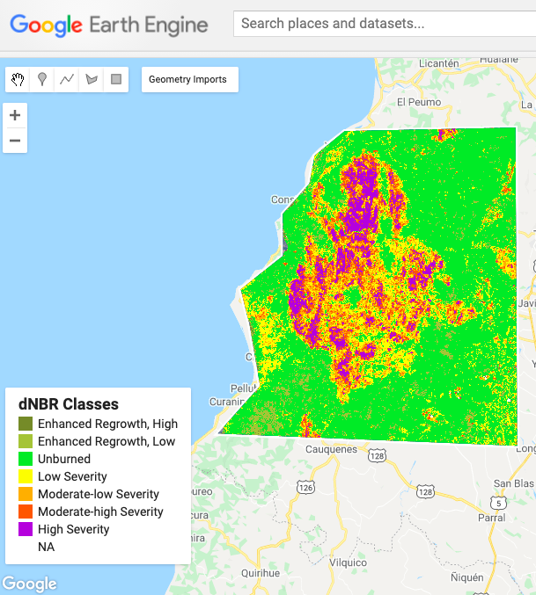

Applications of GEE for Land Management: Burn Severity
Burn severity mapping completed in GEE manipulates pre-loaded Sentinel-2 or Landsat 8 data and uses the GEE platform to do quality control and filter data.
Normalized Burn Ratio (NBR) and differenced NBR (dNBR) are calculated.
Thresholding rates the severity of wildfire burning to complete a full burn severity assessment.
Refer to the step-by-step UN-SPIDER burn severity in GEE training
Example of burn severity mapping using Sentinel-2 data in Empedrado, Chile in February 2017. This map was produced using the UN-SPIDER Burn Severity with GEE script. Credit: UN-SPIDER
Notes:
Alright, so that was our quick survey of relevant data products available, and now I just want to cover some applications for land monitoring related tasks. Hopefully this gives you a bit of an idea about the versatility of GEE and resources that might be helpful for your own work. So first I want to touch on something that I actually previously covered in our fire series that just wrapped up at the end of May. There is a tutorial and script for mapping burn severity in GEE made available by the UN Space-based Information for Disaster Management and Emergency Response program, otherwise referred to as UN SPIDER. This script uses either Landsat 8 or Sentinel-2 imagery to calculate the normalized burn ratio for pre and post fire images, differences the two to create a differenced normalized burned ratio, and then thresholds and maps the results to create burn severity maps for your chosen location. You can see a screenshot of this for Empedrado, Chile in February 2017 after a series of fires burned in the area. If burn severity is a part of your land monitoring efforts, definitely check out this training.

Slide 31
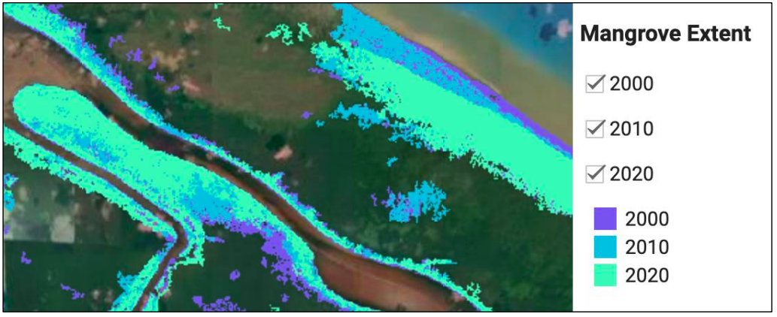
Applications of GEE for Land Management: Mangrove Mapping
ARSET training using GEE to map mangroves:
Remote Sensing for Mangroves in Support of the UN Sustainable Development Goals
Random Forest Classification to create a time series for mangrove extent change
Creation of apps as management and communication tools
The previously mentioned ARSET SAR training also shows methods of using SAR data in GEE to map mangroves.
Example of mangrove extent mapping over a time series to track how mangrove presence has change over a 20-year period (from the exercises completed during the ARSET Mangrove Mapping series).
Image Credit: NASA ARSET
Visit the Data Explorer and Comparison Apps for more information on mangrove mapping and apps in GEE.
Notes:
Another demonstrated application of GEE is mangrove mapping. Our previous training titled Remote Sensing for Mangroves in Support of the UN Sustainable Development Goals goes into detail of how to map mangrove extent and display results in GEE. The training goes step by step through a random forest classification to create a time series of mangrove extent change, and also details the process of creating apps, tools, and graphical user interfaces in GEE to better communicate and display results. You can see an example of outputs from this training here on the slide, displaying mangrove extent for 2000, 2010, and 2020, and note the graphical interface allowing a user to point and click to see results rather than having to edit the code themselves. To learn more about this work in particular, please visit the Data Explorer and Comparison Apps created to display this work. I’ve provided the links on the slide for you to take a look at later. There is also a section of the Forest Mapping and Monitoring with SAR data training I mentioned earlier that goes over techniques in GEE to map mangroves using SAR data.

Slide 32
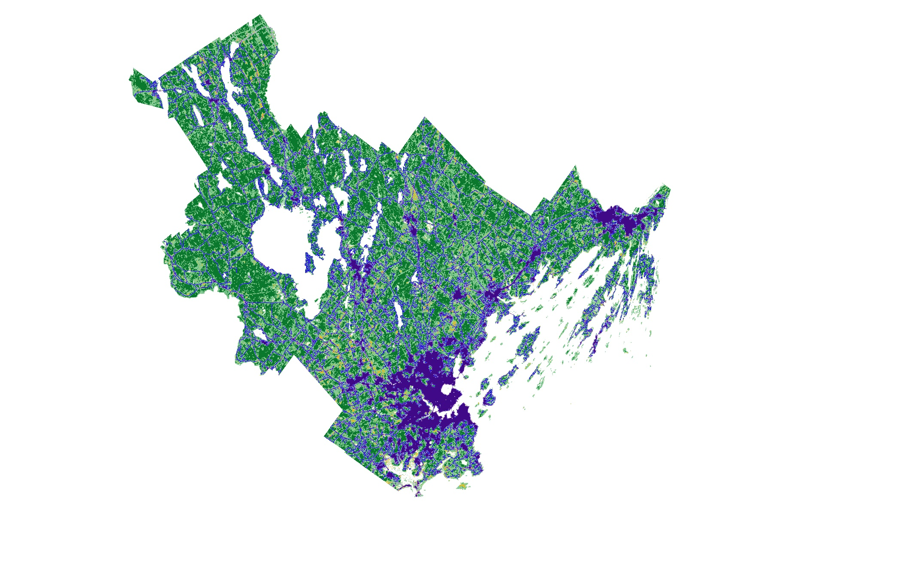
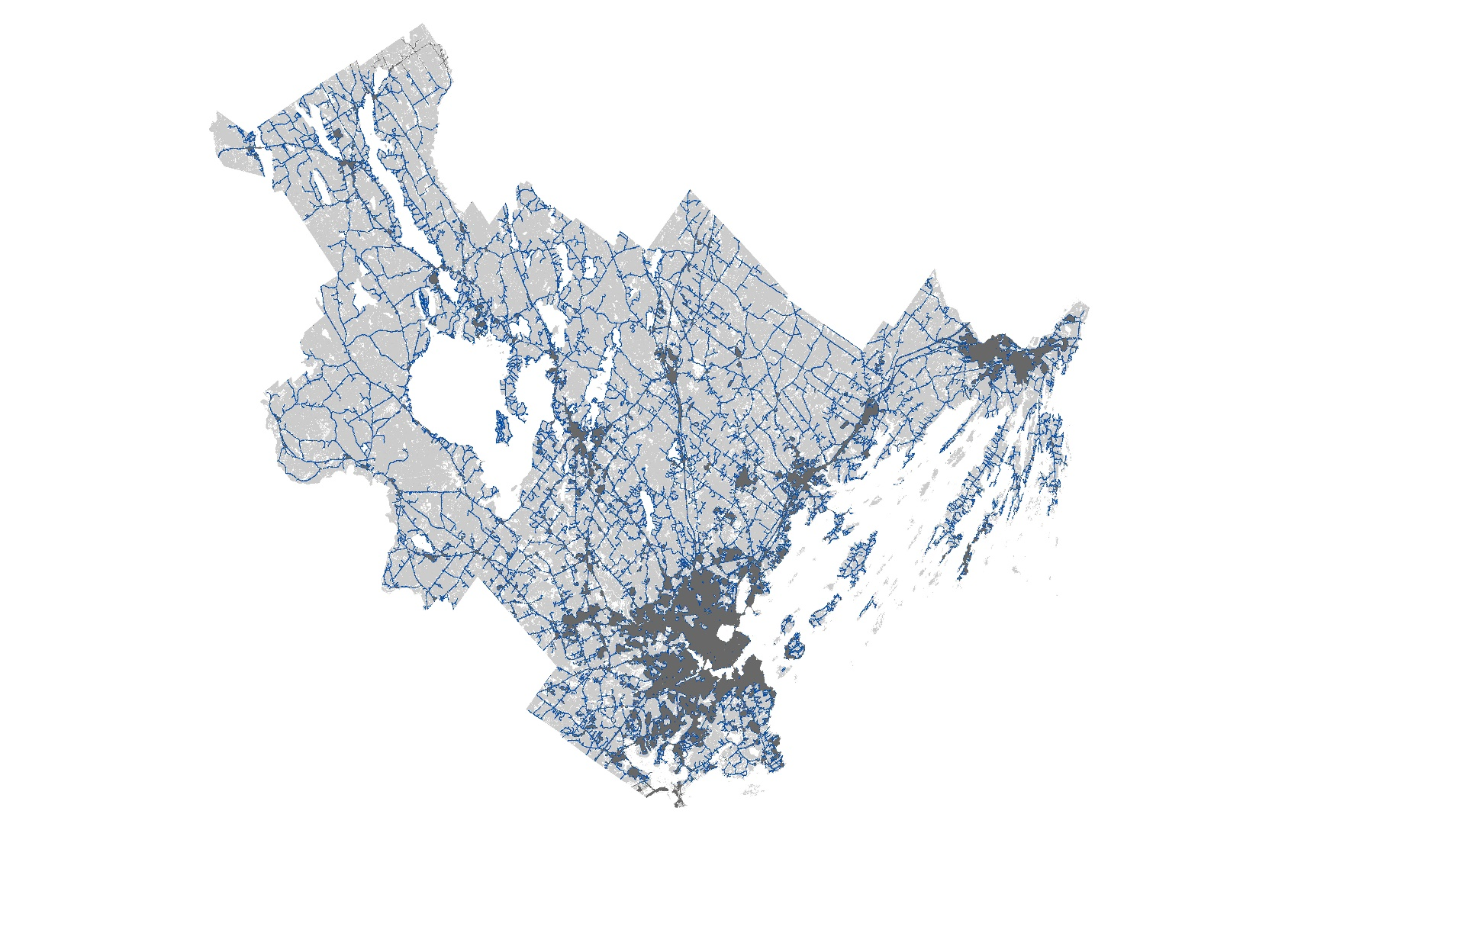

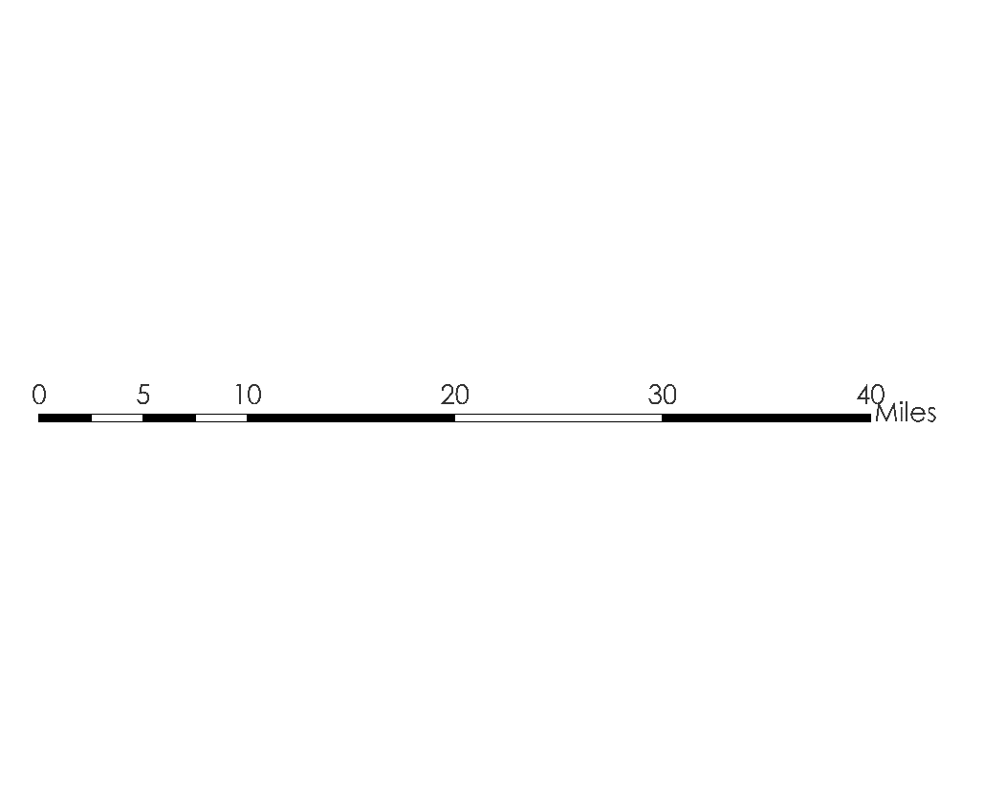
Applications of GEE for Land Management: Land Cover
Urban Development
Urban Edge
Forest Cover
Forest Cover
Forest Edge
Urban Cover
Cultivated
Forest – Urban Edge
0
5
10
20
30
40
Miles
Forest – Urban Edge
Notes:
Here was the team’s final result. The classes used were urban, forest, and cultivated (which accounts for cover types like agriculture). More classes were initially calculated, but it was determined that the most important classes were these three, since the focus of this part of the project was to identify forest-urban edge habitat. The map on the left displays these cover types, the edges of urban and forested areas, and the overlap between the two. In the second map on the right, we see the mapping of forest-urban edge habitat highlighted in blue. Ultimately, the team team was successfully able to identify edge habitat in transportation corridors, the borders of cities and small municipalities, as well as near recreation areas.

Slide 33
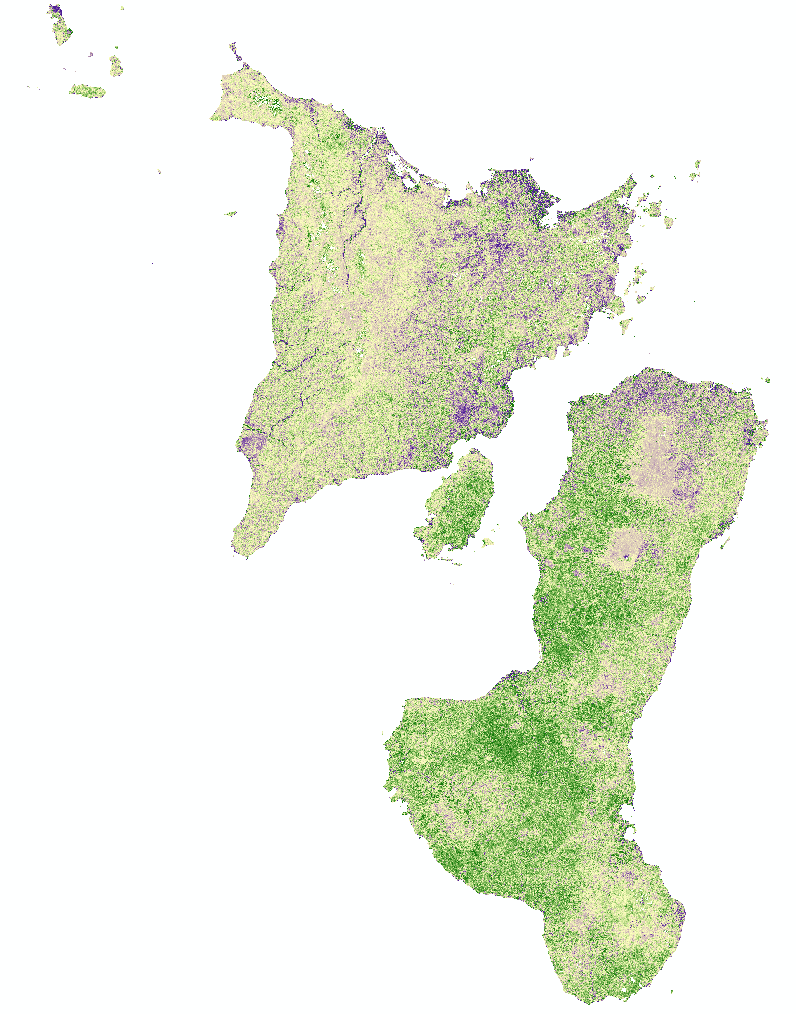
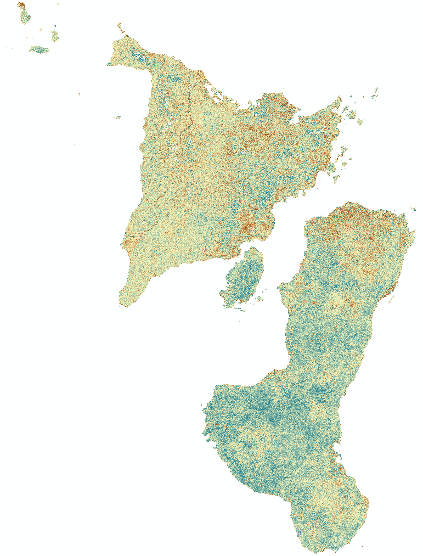

Applications of GEE for Land Management: Vegetation Indices
NDVI Change
EVI Change
NDVI Increase
EVI Increase
No Change
No Change
NDVI Decrease
EVI Decrease
N
0
10
20
30
40
Kilometers
Notes:
Here are there results. They used the Normalized Difference Vegetation Index, or NDVI, and the Enhanced Vegetation Index, or EVI, in GEE to map vegetation change from 2000 to 2019. You probably recognize NDVI, which is a pretty classic index for mapping vegetation, but the team also chose to compute the EVI, since it tends to perform better in areas with dense vegetation. So note that both maps display change in their respective vegetation indices, with the most vegetation decrease observed on the northern Negros Island. And ultimately, conservation managers can use this data to target their habitat restoration efforts and select prime locations for the reintroduction of Visayan warty pig and spotted deer populations.

Slide 34
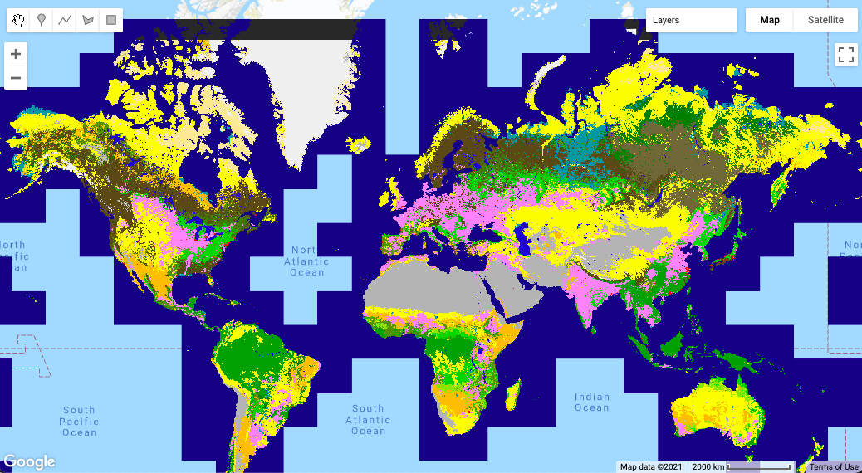
Available Satellite Sensor Data in GEE: Land Cover Products
A variety of land cover data products are available in GEE, including:
ESA WorldCover 10m v200
MODIS Land Cover Type Yearly Global 500m
Global PALSAR-2/PALSAR Forest/Non-Forest Map
USGS National Land Cover Database
GEE Data Catalog:
https://developers.google.com/earth-engine/datasets/tags/landcover
Copernicus Global Land Cover Layers: CGLS-LC100 collection 3 displayed globally in GEE. Credit: Earth Engine Data Catalog
Notes:
I briefly mentioned this on the MODIS slide, but there are also a variety of processed land cover layers available in GEE. I’ve shown an example of one here on the right. This is data from the Copernicus Global Land Cover Layers dataset. There are also layers displaying the MODIS land cover type product, maps of Forest versus Non-Forest area derived from PALSAR data, and access to the USGS National Land Cover database layers. Make sure you take a look at these data catalog links to get a full survey of the available data layers and imagery archives.

Slide 35
Demo – Land Cover Acquisition
Notes:
And I just want to quickly remind you all that this will be a basic intro, so if you’re a little more advanced with GEE, we might go over some things you already know, but this session is to make sure we’re all on the same page with the basics of the platform. Ok let’s get started with our first section discussing GEE functionalities and available data types.

Slide 36
ESA WorldCover 10m v100
Code for demo: https://code.earthengine.google.com/7cba979b0b54d16e8a01e2bf53e426c2
Dataset (GEE): https://developers.google.com/earth-engine/datasets/catalog/ESA_WorldCover_v100
Dataset Availability
2020-01-01 to 2021-01-01
Dataset Provider
ESA/VITO/Brockmann Consult/CS/GAMMA Remote Sensing/IIASA/WUR
Description
The European Space Agency (ESA) WorldCover 10 m 2020 product provides a global land cover map for 2020 at 10 m resolution based on Sentinel-1 and Sentinel-2 data. The WorldCover product comes with 11 land cover classes and has been generated in the framework of the ESA WorldCover project, part of the 5th Earth Observation Envelope Programme (EOEP-5) of the European Space Agency.
Notes:
That concludes our first session in the GEE land monitoring series. Here are some major takeaways from this part. GEE’s cloud-based environment can remove barriers to engaging with remote sensing data, barriers like data storage and personal computing power. And it’s important to note that the functionalities of GEE are similar to many GIS desktop platforms used to do things like create land classifications and calculate environmental parameters from satellite data. GEE also hosts many relevant land monitoring datasets from sensors like Landsat, MODIS, Sentinel-2, and Sentinel-1 SAR. And in our activity you saw the capabilities of the JavaScript API to complete basic functions like imagery filtering and vegetation index calculation. We also briefly explored the Python API hosted in Google Colab. And please make sure to join us next week for our session on Land Cover Classification & Accuracy Assessment.

Slide 37
Summary
The GEE platform provides users with cloud-based computing resources that can decrease barriers like data storage space and personal computing power.
The capabilities of GEE are similar to those of many GIS platforms used to manipulate satellite data for key land-related remote sensing processes, including algorithm application and land cover classification.
GEE hosts many datasets relevant to land monitoring.
Landsat Series, MODIS, Sentinel-2, and Sentinel-1 SAR
The JavaScript API enables coding and automation of basic remote sensing functions like imagery filtering, and vegetation index calculation.
Users interested in the Python API can explore Google Colab.
Session 2: Land Cover Classification & Accuracy Assessment
Notes:
That concludes our first session in the GEE land monitoring series. Here are some major takeaways from this part. GEE’s cloud-based environment can remove barriers to engaging with remote sensing data, barriers like data storage and personal computing power. And it’s important to note that the functionalities of GEE are similar to many GIS desktop platforms used to do things like create land classifications and calculate environmental parameters from satellite data. GEE also hosts many relevant land monitoring datasets from sensors like Landsat, MODIS, Sentinel-2, and Sentinel-1 SAR. And in our activity you saw the capabilities of the JavaScript API to complete basic functions like imagery filtering and vegetation index calculation. We also briefly explored the Python API hosted in Google Colab. And please make sure to join us next week for our session on Land Cover Classification & Accuracy Assessment.

Slide 38
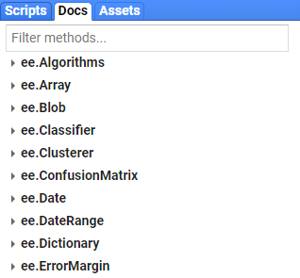
Resources for Help
Using Google Earth Engine for Land Monitoring Applications:
https://appliedsciences.nasa.gov/join-mission/training/english/arset-using-google-earth-engine-land-monitoring-applications
Forest Mapping and Monitoring with SAR Data
https://appliedsciences.nasa.gov/join-mission/training/english/arset-forest-mapping-and-monitoring-sar-data
Docs Tab
Developer’s Guide
Google Earth Engine Developers Group

Slide 39
Demo – Surface Water Acquisition

Slide 40
JRC Global Surface Water Mapping Layers, v1.4
Code for demo: https://code.earthengine.google.com/00e7a7f5521c592d7523cd281b2552c7
Dataset (GEE): https://developers.google.com/earth-engine/datasets/catalog/JRC_GSW1_4_GlobalSurfaceWater
Dataset Availability:
1984-03-16 to 2022-01-01
Dataset Provider:
EC JRC / Google
Description:
This dataset contains maps of the location and temporal distribution of surface water from 1984 to 2021 and provides statistics on the extent and change of those water surfaces. For more information see the associated journal article: High-resolution mapping of global surface water and its long-term changes (Nature, 2016) and the online Data Users Guide. These data were generated using 4,716,475 scenes from Landsat 5, 7, and 8 acquired between 16 March 1984 and 31 December 2021.

Slide 41
Resources for Help
Using Google Earth Engine for Water Resources Applications:
https://developers.google.com/earth-engine/datasets/tags/surface
Using Earth Observations to monitor Water Budgets for River Basin Management:
https://appliedsciences.nasa.gov/join-mission/training/english/arset-using-earth-observations-monitor-water-budgets-river-basin-0
Mapping and Monitoring Lakes and Reservoirs with Satellite Observations:
https://appliedsciences.nasa.gov/join-mission/training/english/arset-mapping-and-monitoring-lakes-and-reservoirs-satellite

Slide 42
Thank You!

